Slide 1
Query Processing -A voice bot
18BCI0193-K.SAIVIKAS
18BCI0196-BANDARU ADARSH REDDY

Slide 2
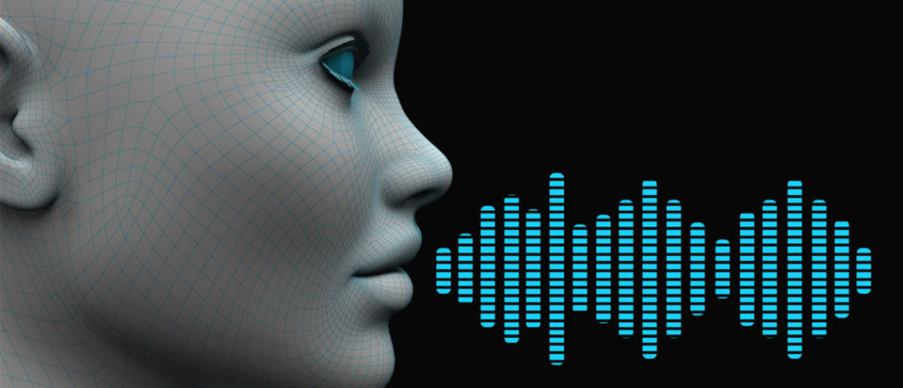
REVIEW-1
.

Slide 3
Abstract
Human – computer interaction is increasing exponentially in the market of computer science and artificial intelligence.
Voice interaction is one of the advancements in the Human-computer interaction.
The main goal of the project is to develop a voice bot which recognizes the question asked by the user.
It searches for appropriate results over the internet using the keywords
The application replies us with apt answers by converting it back to speech

Slide 4
Introduction
Speech is the best and efficient way of communication
Speech recognition is dominating the market and has taken over traditional ways of using hectic interfaces such as mouse and keyboard.
Speech recognition is providing us with fast access to the information that we need.
Addition of speech recognition to interactive response systems helps us add computation and responsiveness to voice
The focus of this project is to develop an application that takes user speech as input, processes it and replies to the user in speech

Slide 5
Literature Review
An Intelligent Web based Voice Chatbot
Authors: Manoj Lal, S. Sinha, S. J. du Preez
This paper provides a web-based technology which consists of three parts. They are the client, server and data acquisition
The client has to collect the audio data from the user.
Processing the audio data and converting into text can be done on the client -side as well as the server side. Here we follow client -side processing to reduce the computational time and resources when we are dealing many parallel inputs at the same time for server
The data acquisiton phase collects the text data searches for key words and comes up with a solution.
The testing of the software is done using the black box technique.

Slide 6
Literature Review
Smart Voice Search Engine
Author: Shahenda Sarhan
This paper provides us with smart voice-based search engine
The paper focuses on the speech recognition phase.
Initially the audio signal is taken, it is converted into digital signals
These digital signals are split into frames and sent to the acoustic analysis.
After the analysis, the keyword is generated and is sent to the search engine for getting the result.
The final query result is given to its user.
The problems faced by the designers are explained later in the paper.

Slide 7
Literature Review
Chatbot Using Knowledge in Database: Human to Machine Conversational Modelling
Authors: Bayu Setiaji and Ferry Wahyu Wibowo
A chatbot tries to communicate with humans in a natural way.
It takes input from the user, finds the similarity between the words of input and various referential knowledge of the system
It consists of the Relational Database Management System (RDBMS) and the interface that is accessing the core of RDBMS
The similarity decides the strength of the answer given by the system
The interface is designed using the languages Pascal and Java

Slide 8
Literature Review
Development Of Speech-to-Text Chatbot Interface Based on Google API
Authors: Nataliya Shakhovska, Oleh Basystiuk and Khrystyna Shakhovska
This paper describes possibilities which are provided by open API’s like Google for creating unified interfaces.
Speech recognition is growing popularly in the field of natural language processing as it saves the communication time
Audio data is collected from various sources such as the social networks and neural networks are used for training this data.
Python language and web framework Flask are used for this paper.
The complexity of finding the keyword in the database is reduced using Hash bot algorithm

Slide 9
Motivation
Speech Recognition is one of the emerging technologies of the present time.
Communication with a computer using audio helps us save time and provides us with efficient results.
Wikipedia is one of the modern source of information and many of the websites depend on it for apt results
My main goal is to design an application which takes user speech as input and provides us with speech response.

Slide 10
Methodology
Chatbot typically provide a speech and text-based user interface, allowing the user to speak the commands and receive as speech to text response.
When chat bot technology is integrated with popular web services such as Wikipedia, it can be utilized securely by an even larger audience.
A Wiki-Chat Bot project is developed using AI techniques that analyze user’s queries and processes the query.
This system is an application which provides appropriate responses to the query effectively.
Users just have to query through the bot through speech
The System uses artificial intelligence to answer the query.

Slide 11
Methodology
The results are accurate according to the user’s queries.
The system analyzes the query and then responds to the user.
The user can query about any questions with the help of this application.
This system helps the users to search easier.

Slide 12


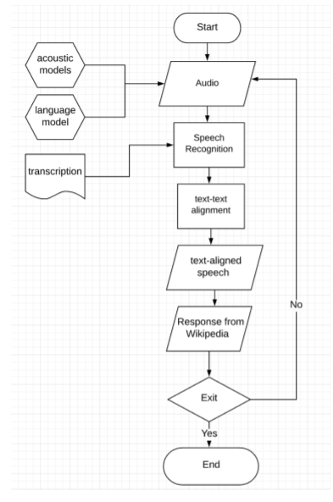




Slide 13
References
[1] An Intelligent Web-Based Voice Chat Bot ,Manoj Lall, S. Sinha, S.J. du Preez(June 2009)
[2] Smart Voice Search Engine, Shahendra Sahan(2014)
[3] Chatbot Using a Knowledge in Database: Human-to-Machine Conversation Modeling, Ferry Wahyu Wibowo, Bayu Setiaji (January 2016)
[4] Development of the Speech-to-Text Chatbot Interface, Nataliya Shakhovska, Oleh Basystiuk , Khrystyna Shakhovska.(2019)
[5] Chatbots: Are they Really Useful?, Bayan Abu Shawar, EriAtwell(January 2007)
[6] Interactive Voice Response System, John Brian Pickering(2004)

Slide 14
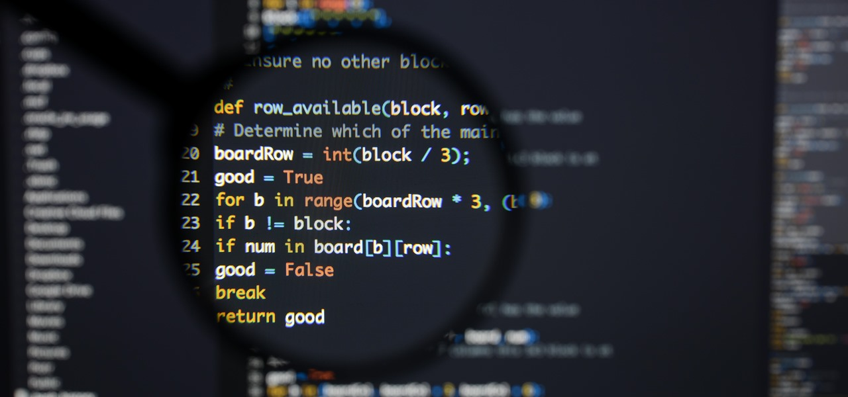
REVIEW -2 & 3

Slide 15
Implementation – Modules
TKINTER
It is an inbuilt module that comes with python that allows you to create graphical user interfaces relatively easy and quickly.
It creates a graphical user interface, we can set the size of the window, create buttons, print text onto the interface and run the loop
To download the package onto the system we use the following command:
sudo apt – get install python3 – tk
Tkinter is imported into the program. Tkinter GUI operations are all performed as considering objects as widgets
The root widget is declared and run till the program is closed using the main loop function.
Two different windows are created acting as the input and the output window. Their titles are set, and the pack() function is used to print the data into the interface

Slide 16
Implementation - Modules
WOLFRAMALFA
Wolframalfa is a library which helps in building the main program which searches for the query and provides us with the result of the query.
The package is downloaded from the internet using the command:
python3 install –m pip install wolframalpha
This package is imported into the program and a variable is created called as appID which stores the app ID of the wolframalfa application.
We give this ID to the client and open up the connection.
When the query is converted from speech to text, it is given as input for the wolframalpha using the query() function.
The result of the query is taken out and forwarded to the text to speech to give output ot the user.

Slide 17
Implementation - Modules
WIKIPEDIA and other packages
Wikipedia is a vast source of information over the internet.
Adding Wikipedia to the program helps us find apt answers to the keyword we have searched.
It is downloaded into the Ubuntu system using the command:
python3 –m pip install wikipedia
Some of the other packages include the Speech Recognition , pyaudio which stands for Python Audio, playsound and gTTs
Downloading the packages and installing into the system is as follows:
python3 –m pip install SpeechRecognition
python3 –m pip install gTTs
python3 –m pip install playsound
python3 –m pip install pyaudio

Slide 18
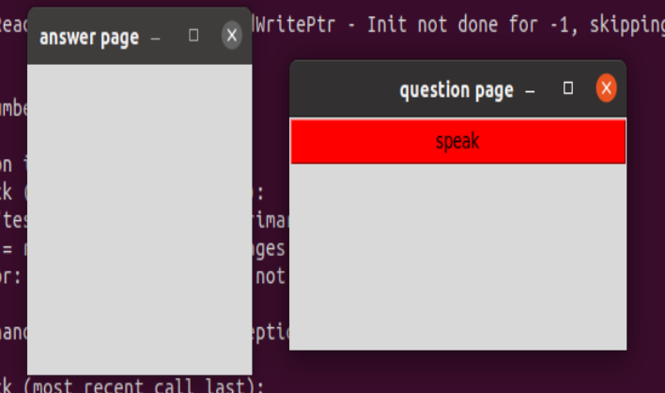
Results Initial Question and Answer Page after running the program

Slide 19
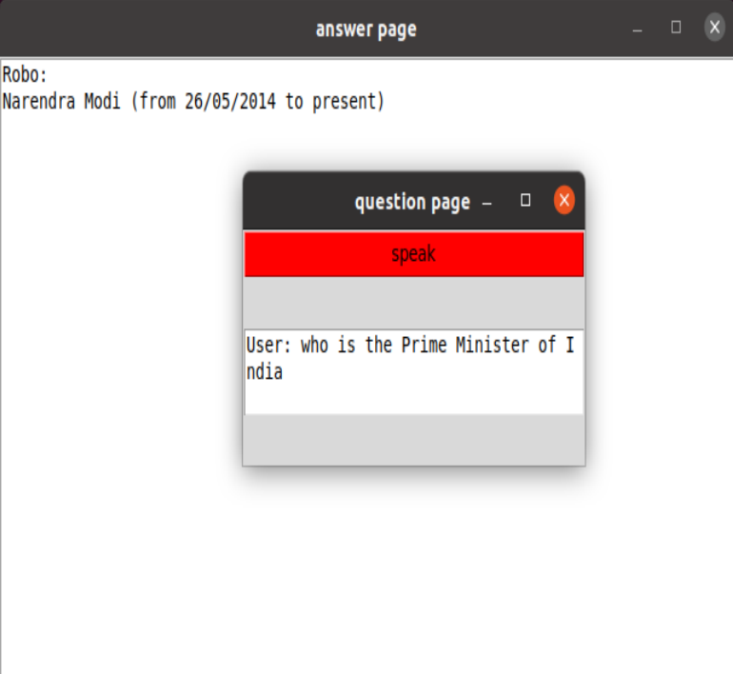
Results After clicking on the speak button, the user speaks which is converted to text and taken for query and result is generated.

Slide 20
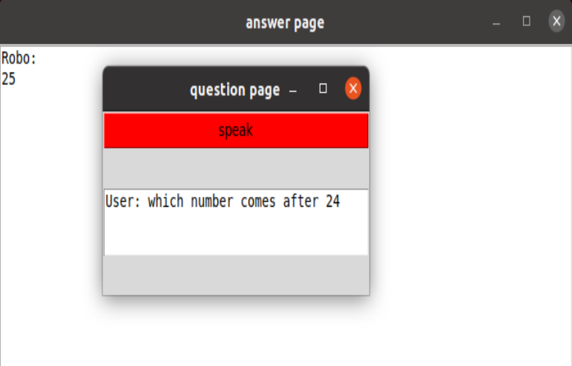
Results Some other examples:

Slide 21
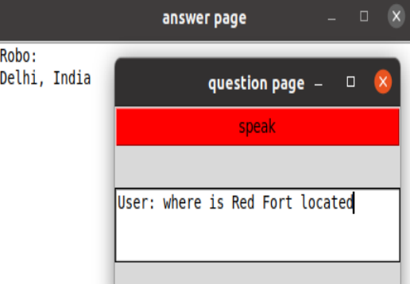
Results Some other examples:

Slide 22
Comparison with already existing technology:
The major advantage of this project over other existing technologies is that is doesn’t need a server and a client to perform the operation.
All the operation is being performed on the client’s i.e., on the user’s computer.
The program runs by itself and doesn’t connect to any server which helps reduce the problem of heavy resources when parallely processing large amount of data.
Another advantage is that it depends on one of the best search sites i.e., Wikipedia for its information. Wikipedia is the most reliable source of information over the internet.

Slide 23
THANK YOU

